Slide 1
Introduction to Psychology
Chapter 8 Emotions
Sadia Qazi
Sadia.Qazi@ucp.edu.pk

Slide 2
Intrinsic & extrinsic
Instinct Approaches: Born to Be Motivated
Drive-Reduction Approaches: Satisfying Our Needs
Arousal Approaches: Beyond Drive Reduction
Incentive Approaches: Motivation’s Pull
Cognitive Approaches: The Thoughts Behind Motivation
Maslow’s Hierarchy: Ordering Motivational Needs
Applying the Different Approaches to Motivation

Slide 3
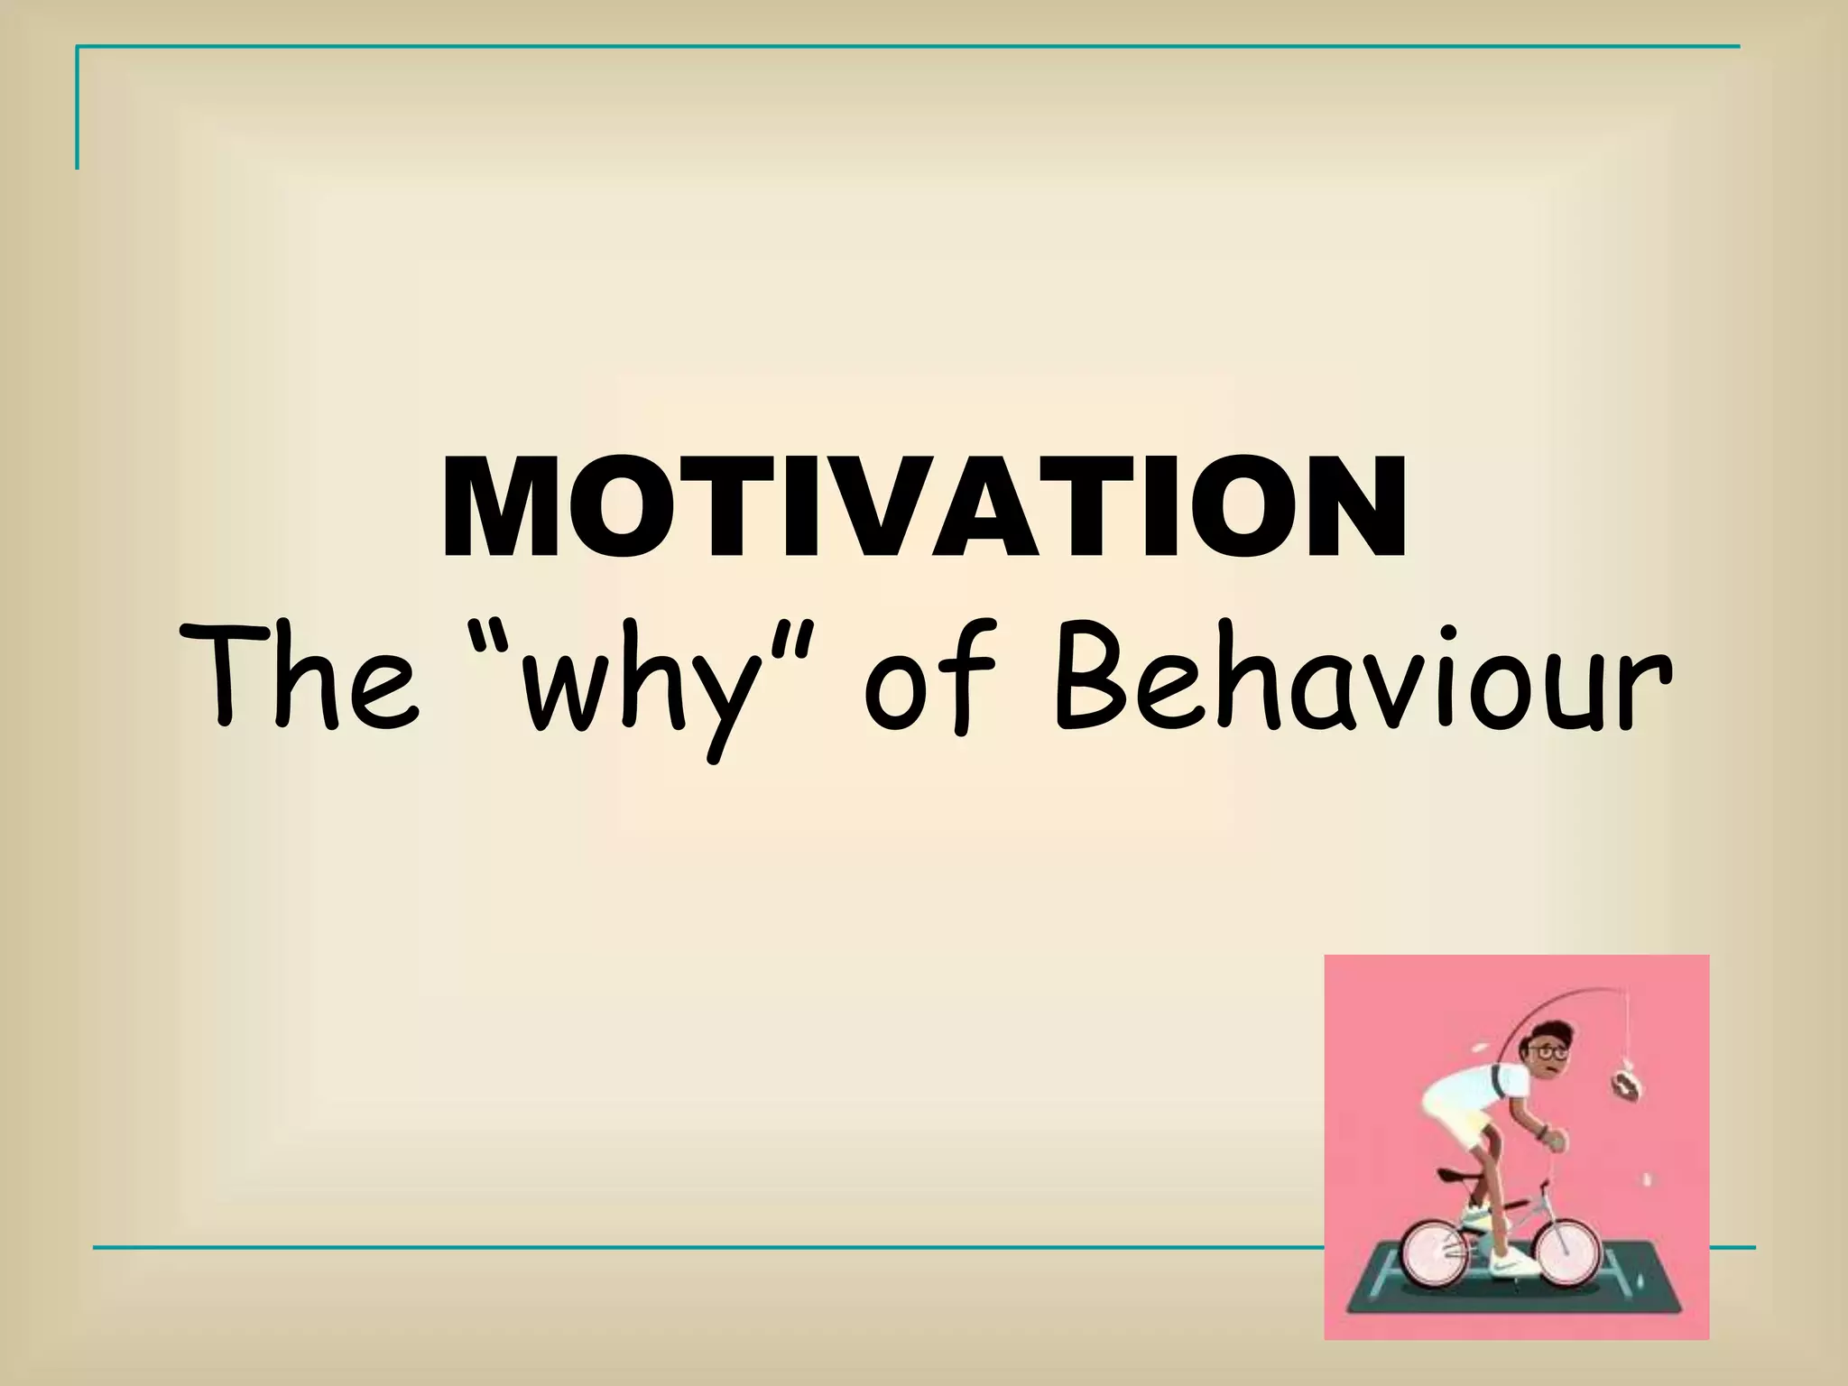

Slide 4
What is Motivation?
Motivation refers to the internal processes and external influences that initiate, direct, and sustain human behavior toward achieving specific goals. It is the force that determines why people act, how much effort they put in, and how persistent they are in pursuing a task or objective.
In other words, motivation is what drives individuals to act in particular ways—to start an activity, continue it, and work toward desired outcomes.

Slide 5
Key Elements of Motivation
Activation: The decision or trigger to begin a behavior. Example: Deciding to start learning a new programming language.
Persistence: The continued effort toward a goal despite challenges or obstacles. Example: Continuing to debug code even after repeated errors.
Intensity: The level of focus and energy put into achieving the goal. Example: Spending extra hours perfecting a software project before a deadline.

Slide 6
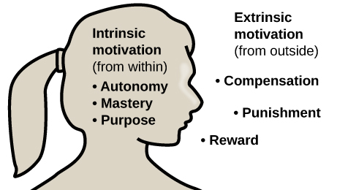
INTRINSIC VS EXTRINSIC MOTIVATION
Motivation – the wants or needs that direct behavior toward a goal.
Intrinsic motivation:
Intrinsic motivation refers to engaging in an activity or behavior because it is inherently enjoyable, interesting, or personally satisfying. The motivation comes from within, driven by internal factors such as curiosity, a sense of competence, or the enjoyment of the task itself.
Characteristics:
Activities pursued for their own sake.
Individuals find the task inherently rewarding.
Associated with creativity, deep learning, and sustained interest.
Examples:
Reading a book for personal enjoyment.
Engaging in a hobby purely for the pleasure it brings.
Solving a challenging puzzle out of curiosity.

Slide 7
Extrinsic motivation:
Extrinsic motivation involves engaging in an activity or behavior to attain a separate outcome or external reward. The motivation comes from external factors such as rewards, recognition, or avoiding punishment, rather than inherent enjoyment of the activity itself.
Characteristics:
Activities pursued for external rewards or outcomes.
Motivation driven by external factors.
May involve the desire for recognition, grades, or financial gain.
Examples:
Studying for a test to earn a good grade.
Working on a project to receive a bonus.
Completing chores to avoid punishment.

Slide 8
Instinct Approaches: Born to Be Motivated
Theory: Instinct Theory of Motivation Theorists: William James (1890), William McDougall (1908)
Explanation: The instinct approach suggests that much of human behavior is innate and biologically programmed. Instincts are inborn tendencies or patterns of behavior that help organisms survive and reproduce.
William James proposed a list of human instincts such as fear, love, curiosity, and cleanliness. McDougall later expanded on this, arguing that instincts provide the foundation for complex social behaviors. Although later research has shown that human behavior is more flexible than pure instinct, this theory laid the groundwork for studying the biological bases of motivation.
Example in Psychology: An infant’s sucking reflex or a parent’s instinct to protect their child.

Slide 9
Drive-Reduction Approaches: Satisfying Our Needs
Theory: Drive-Reduction Theory Theorist: Clark L. Hull (1943)
Explanation:
Hull proposed that motivation arises from biological needs that cause internal states of tension, or drives. Individuals act to reduce these drives, thereby maintaining a balanced physiological state known as homeostasis.
For example, hunger produces a drive that motivates eating; thirst produces a drive that motivates drinking. Once the need is satisfied, the drive decreases, and the body returns to balance. Drive-reduction theory focuses mainly on physiological rather than psychological needs.
Example in Psychology: A person eats when hungry or drinks water when thirsty to reduce internal tension caused by deprivation.
Example in Computer Science: A system detects low memory or overheating and automatically runs corrective processes to restore balance — analogous to humans acting to satisfy physiological or psychological needs.

Slide 10
Arousal Approaches: Beyond Drive Reduction
Theory: Arousal Theory of Motivation; Yerkes–Dodson Law Theorists: Donald O. Hebb (1955); Robert M. Yerkes and John D. Dodson (1908)
Explanation: Arousal theory states that individuals are motivated to maintain an optimal level of arousal—not too low (boredom) and not too high (stress). The Yerkes–Dodson Law suggests that performance increases with arousal up to a point, after which excessive arousal reduces performance.
Example in Psychology: An athlete performs best under moderate pressure but may fail if the stress level is too high.

Slide 11
Incentive Approaches: Motivation’s Pull
Theory: Incentive Theory of Motivation Theorist: B.F. Skinner (1938) and other behaviorist psychologists
Explanation: Incentive theory focuses on external stimuli that “pull” individuals toward particular behaviors. Motivation arises not from internal needs but from the desire to obtain rewards or avoid negative outcomes. This theory is grounded in operant conditioning, where behavior is shaped by reinforcement.
Example: An employee works overtime to earn a bonus or recognition.

Slide 12
Cognitive Approaches: The Thoughts Behind Motivation
Theories: Expectancy-Value Theory; Cognitive Theory of Motivation Theorists: John W. Atkinson (1957); Victor H. Vroom (1964)
Explanation:
Cognitive theories argue that motivation is largely determined by mental processes, including beliefs, expectations, and values.
Expectancy-Value Theory states that motivation is a function of two key factors: the expectation of success and the value placed on that success.
Vroom’s Expectancy Theory further emphasizes that individuals choose actions based on their expectations of outcomes and the desirability of those outcomes.
Motivation therefore depends on whether people believe their efforts will lead to desired results and whether those results are meaningful to them.
Example in Psychology:
A student studies intensively because they believe effort will lead to academic success, and they value that success highly.

Slide 13
Maslow’s Hierarchy of Needs: Ordering Motivational Needs
Theory: Hierarchy of Needs Theorist: Abraham H. Maslow (1943)
Explanation: Maslow proposed that human motivation is organized in a hierarchical structure of needs, progressing from basic physiological requirements to higher psychological and self-fulfillment goals. Individuals move upward as lower needs are satisfied.

Slide 14
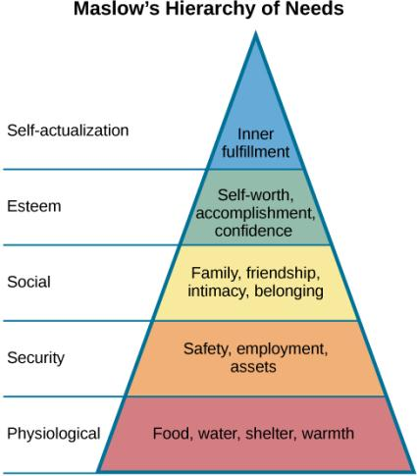
MASLOW’S HIERARCHY OF NEEDS
Abraham Maslow (1943)
Proposed a theory of motivation that spans the spectrum of motives including biological, individual and social.
One must satisfy lower-level needs before addressing the needs in higher levels.
A person without food, water and shelter is unlikely to be focused on relationships or what people think of them.

Slide 15
SELF-EFFICACY & SOCIAL MOTIVATION
Self-Efficacy
Self-efficacy – an individual’s belief in her own capability to complete a task.
Bandura:
Theorized that self-efficacy plays a role in motivating behavior.
Argues that motivation derives from expectations held about the consequences of behaviors.
Beliefs about our abilities will determine what we do and goals we set for ourselves.
Social Motives
Need for achievement – drives accomplishment and performance.
Need for affiliation – encourages positive interactions with others.
Need for intimacy – causes us to seek deep, meaningful relationships.

Slide 16
What Is Achievement Motivation?
Achievement motivation is defined as the need for achievement and is an important determinant of aspiration, effort, and persistence when an individual expects that his performance will be evaluated in relation to some standard of excellence.
In the case of my workout, I was pushing myself to get the best possible score, knowing it would be measured against all other athletes and written on the board for everyone to see.
Achievement refers to competence (a condition or quality of effectiveness, ability, sufficiency, or success). Motivation refers to the energization (instigation) and direction (aim) of behavior. Thus, achievement motivation may be defined as the energization and direction of competence-relevant behavior or why and how people strive toward competence (success) and away from incompetence (failure).

